Slide 2
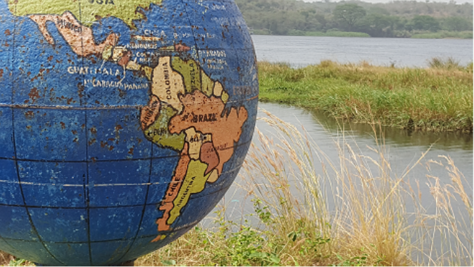
West Nile Social Work Project
Dr Sukhwinder Singh, RSW, Assistant Professor of Social Work United Arab Emirates University

Slide 3
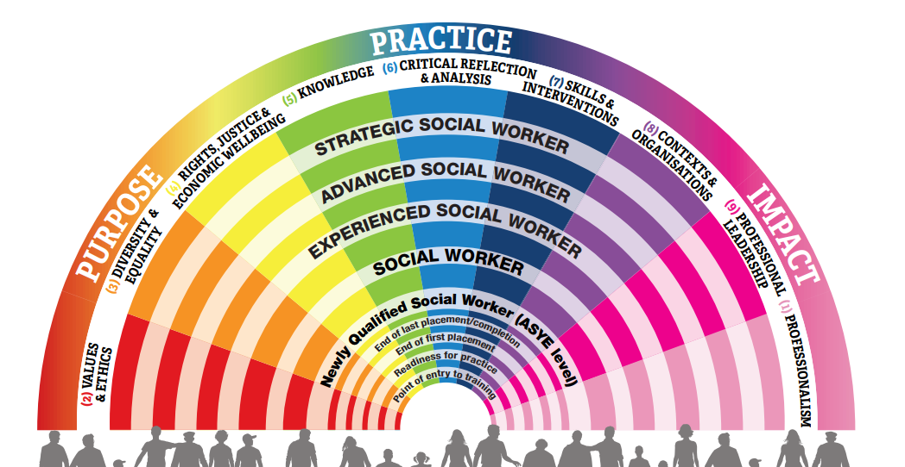
Altruism, Social Protection & Humanitarian Action - Service to Allah -

Slide 4
Utilitarian principles
أخلاق الواجب
Ethics of Duty & Committed Scholarship (Bystanders, ‘Taking Sides’ )
Ethics of Care (Virtuous and Relational Ethics) أخلاقيات الرعاية
Ethics of Responsibility –global interdependency and emotional intelligence
أخلاقيات المسؤولية
4

Slide 6
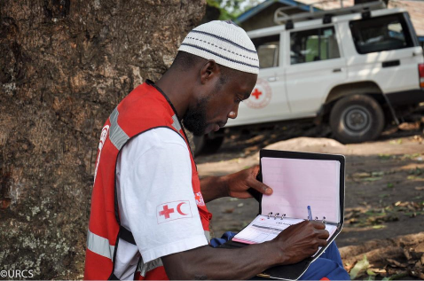
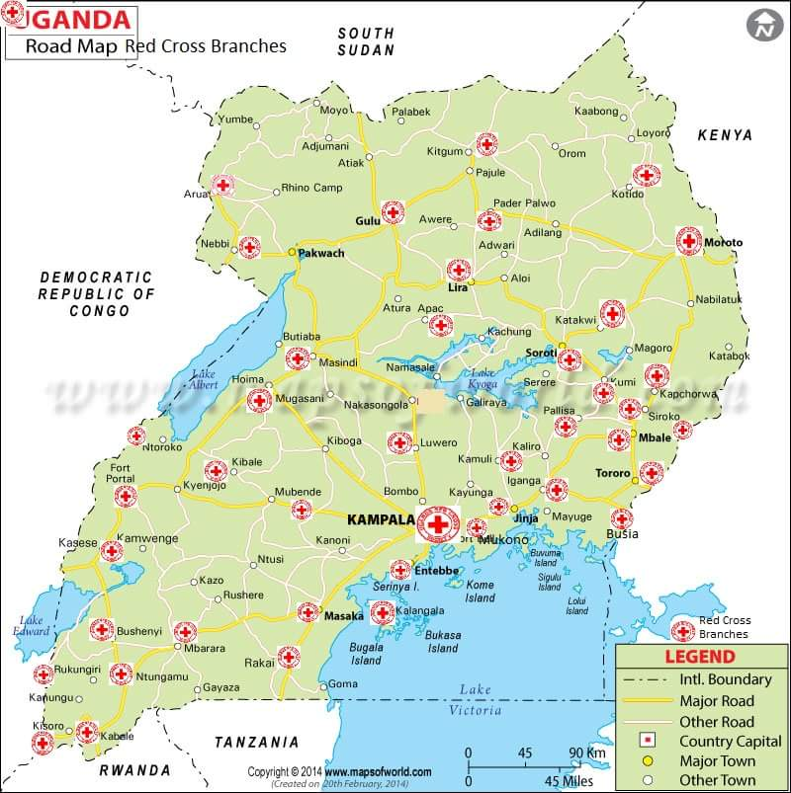
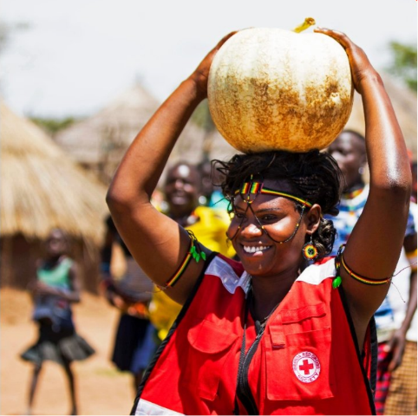

Slide 7
Guiding Principles ‘Everyone’s Business’ DFID Enhanced Safeguarding Standards
Work
Work in partnership with stakeholders, consulting with staff and beneficiaries to co-produce training materials relevant to role and context.
Build
Build capacity in the organisation.
Promote
Promote a human rights-based approach to safeguarding – children and adults have the right to live free from abuse and exploitation.
Recognize
Recognise indigenous knowledge and the skills and practices in the workforce and learn from and build on these.
Ensure
Ensure sustainability.
Work
Work in partnership with stakeholders, consulting with staff and beneficiaries to co-produce training materials relevant to role and context.
Build
Build capacity in the organisation.
Promote
Promote a human rights-based approach to safeguarding – children and adults have the right to live free from abuse and exploitation.
Recognize
Recognise indigenous knowledge and the skills and practices in the workforce and learn from and build on these.
Ensure
Ensure sustainability.

Slide 8
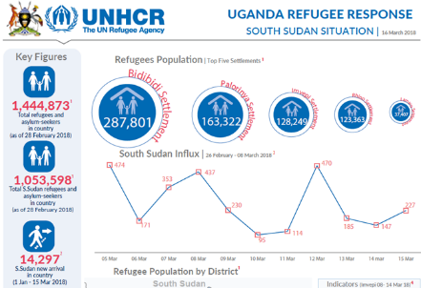
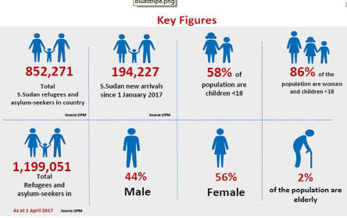
‘Liquid Modernity’ (Bauman)
Scale & Gravity of Refugee crisis

Slide 9
Not A Blank Page
There are currently knowledge, skills and practices in the workforce
There is a national and international legal framework
There is resilience as well as vulnerability
There is harm associated with some traditional practices - FGM
There is no single story
Indigenous knowledge

Slide 10
Measuring Learning, Evidencing Social
Impact &
Anchoring Practice

Slide 12
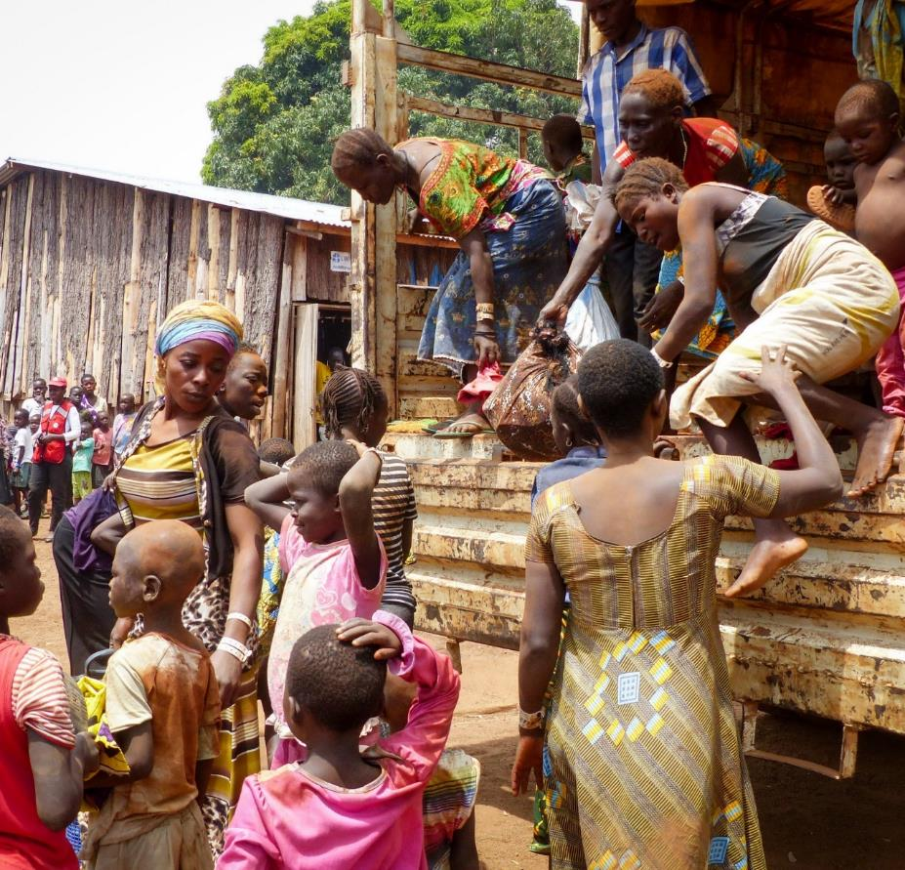
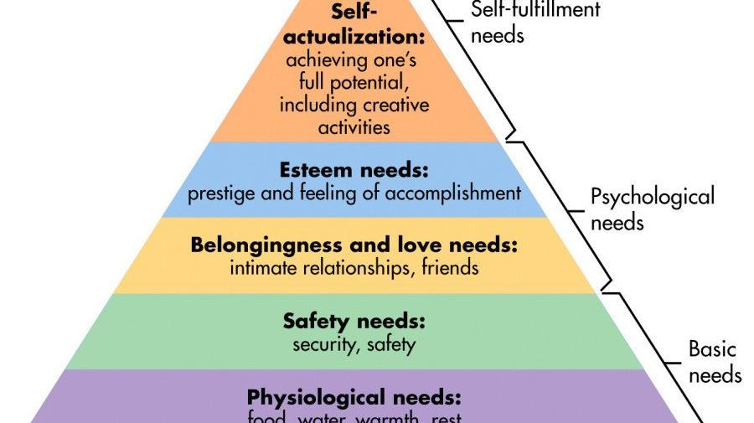

Slide 13
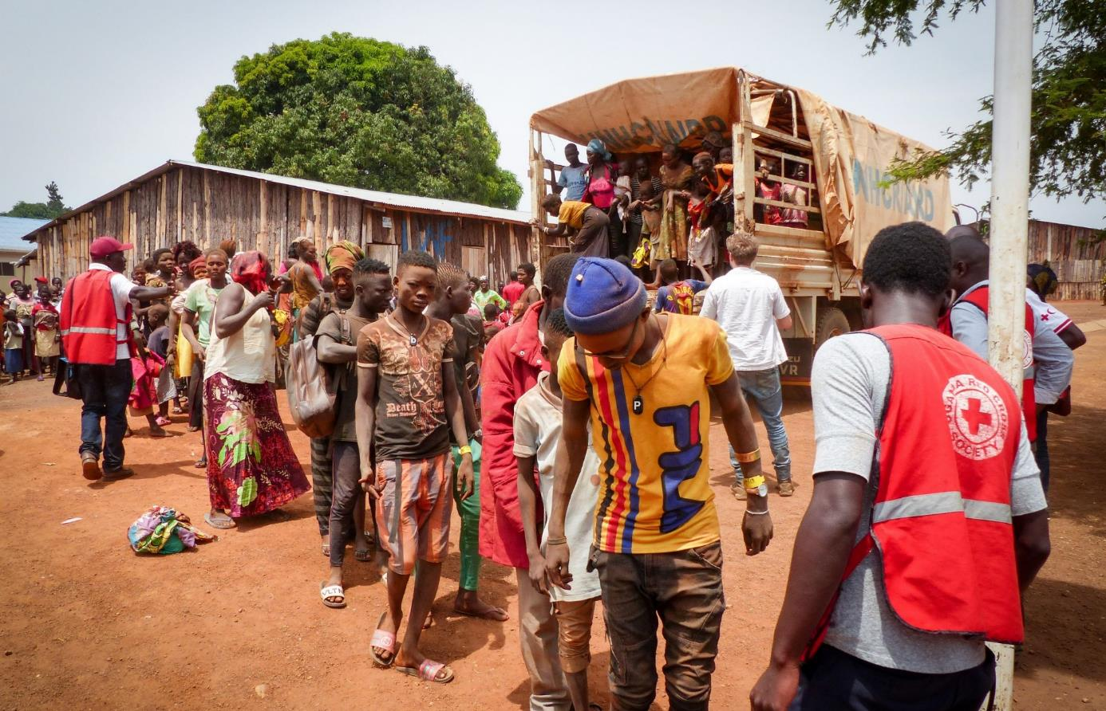

Slide 14
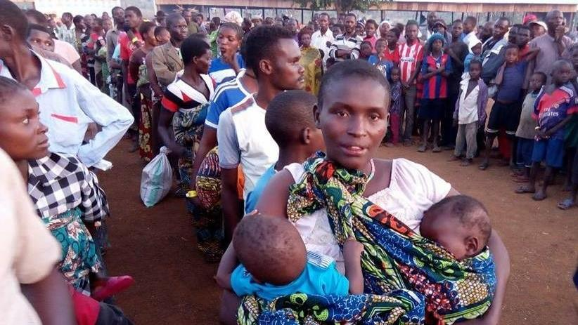

Slide 15
Construction & Representation – Open doors policy

Slide 16
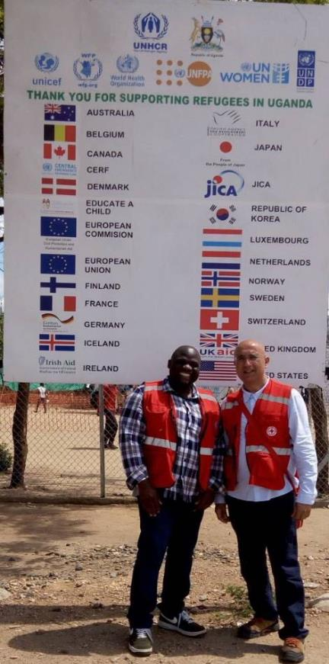
Global Skills
Interprofessionalism Shared Purpose. Mutual Trust, Networking. Innovation, Creativity &
Measuring social impact
FRUGAL PRAXIS
Global
Attributes
Action Orientation Interrogation & Critique Social Responsibility Emotional Literacy Perseverance - Resilence Resourcefulness
Global
Behaviour
Humility, Privileged dialogue Using Leadership to enable others ( Mavericks,.
Hyperconnected & Activists)

Slide 17
West Nile – UAE Social Work Project
Knowledge Base
Shared Learning
Capturing outcomes
Assessing Impact
SDG’s
Planning for phase2 IASSW UNICEF
Enhancing practice education
Monitoring & evaluation
Values & Praxis
Shaping Practice
Reach & Capacity
Developing Human Knowledge Capacity in Safeguarding work
Building Organisational Capacity in Safeguarding Systems & Processes
Delivering training the trainers
Virtual Mentoring& Support
Piloting screening & risk tools
Rolling out across Uganda - Red Cross
2020-2023
4 Year Plan
Uganda National Launch
Remote Supervision
Sustainability
Co-Development
Develop resources & training materials
Initial ground work
Action planning
Steering Group
Project proposal
Scoping work
Committed Practice

Slide 18
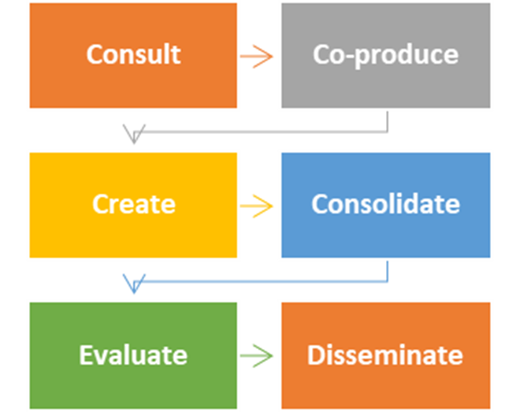
“Standing Still is not an option”

Slide 19
