Slide 1
UNAIDS | March 2021
Africa: Contemporary and Future Health Challenges
DIHAD
COVID-19 and HIV: Ending inequalities

Slide 2
(The right to health means that no one disease should be fought
at the expense of the other.)
Winnie Byanyima, UNAIDS Executive Director
Notes:
Excellencies and colleagues, all protocol observers
I would first like to thank the DIHAD committee for the invitation and to congratulate the organizers on this 17th DIHAD Conference. I am particularly delighted to be speaking today about HIV – I have been advocating for this since 2018 and welcome the opportunity.
Introduction
I want to start with a quote from our esteemed Executive Director, Ms Winnie Byanyima:
The right to health means that no one disease should be fought at the expense of the other.
As we all know, now as never before resources for health are inadequate and constrained. National budgets are under pressure; donors are withdrawing; humanitarian response plans across the world are seriously underfunded; and emerging pandemics – most recently COVID-19 – are drawing attention and money from existing health challenges. We must address this issue or the health of millions will be at ever-increasing risk. Over its lifetime, UNAIDS has learnt a number of key lessons about ending inequalities to guarantee the right to health. These can be applied not only to the HIV response but beyond – and today I would like to outline how this can be done.

Slide 3
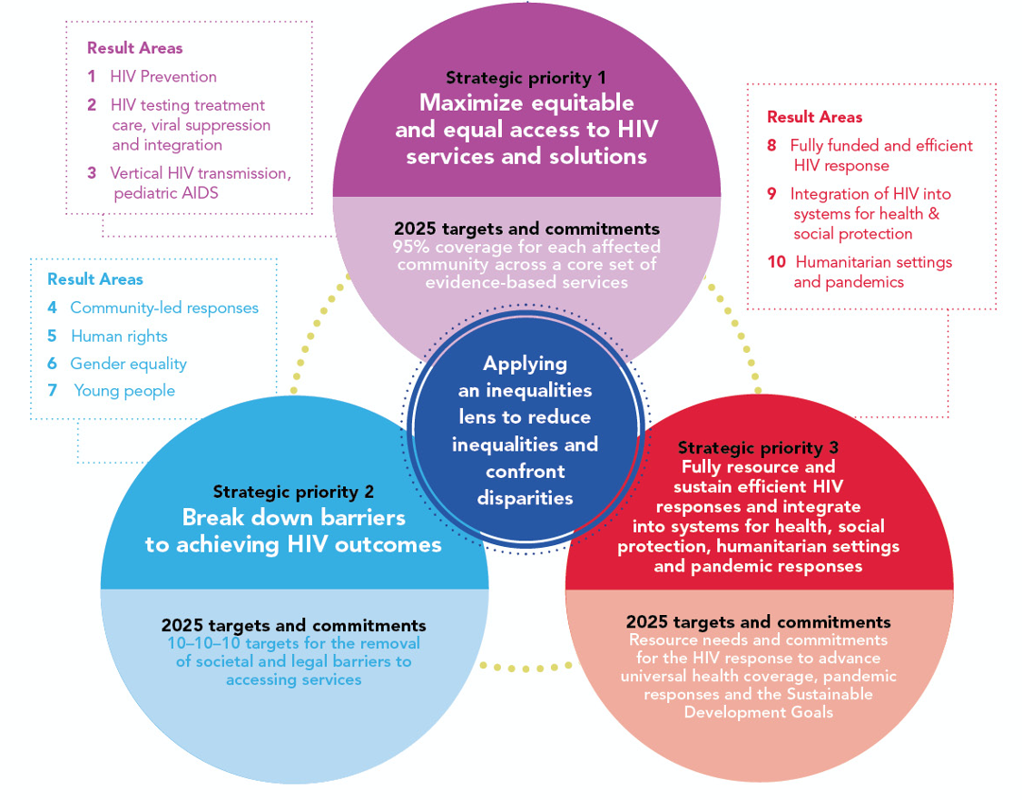
End AIDS as a Public Health threat by 2030

Slide 4
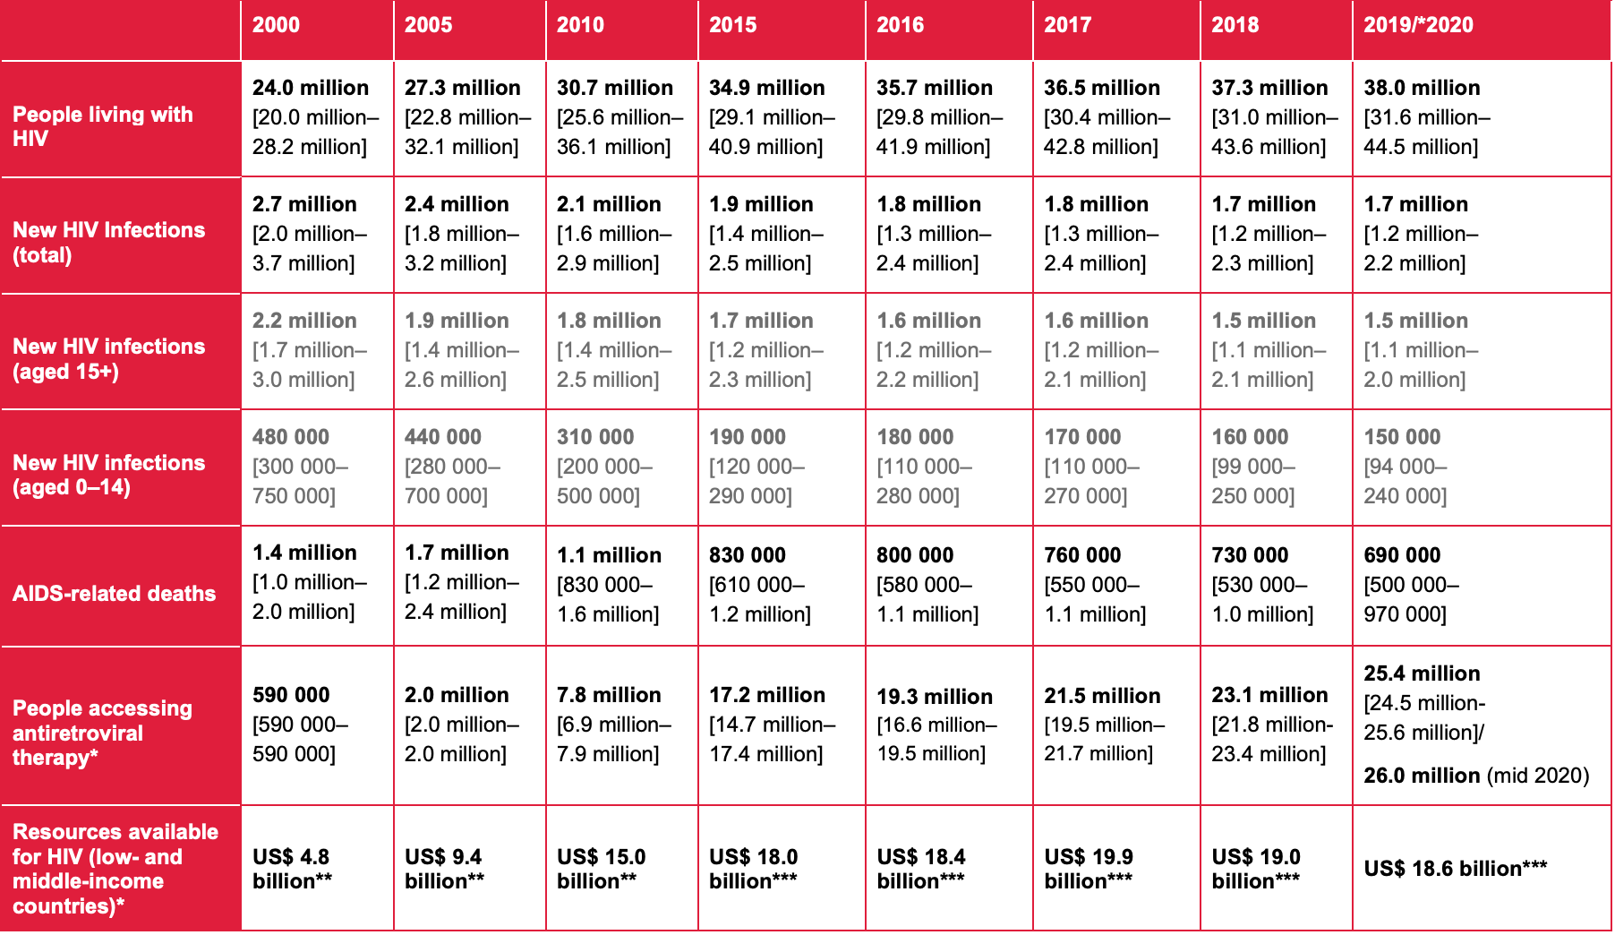
Global HIV data
Notes:
Data shows an increased number of PL HIV from 2000 to 2020 from 24 million to 38 million.
Although new infections have decrease from 2.7 million we are now at 1.5 million in 2020
Ressources aivalable were 4.4 billion in 2000 while more than 18.6 billion were needed in 2020.
without a dedicated resources in 2021 can not end HIV.

Slide 5
Multiple threats: Health in Africa
Disease
Emerging pandemics
Intersecting inequalities
Fragile health systems
Mobility, crisis and humanitarian emergencies
Climate change
Notes:
There are multiple threats to health in Africa Disease – including HIV
Emerging pandemics – including COVID-19
Without access to medicines, Africans are susceptible to the three big killer diseases on the continent: malaria, tuberculosis and HIV
Globally, 50% of children under five who die of pneumonia, diarrhea, measles, HIV, tuberculosis and malaria are in Africa
Double burden communicable/non-communicable diseases - non-communicable diseases the greatest future threat
Intersecting inequalities
Ebola, Zika - and now COVID-19
Social, economic, racial and gender
In access to health services (e.g. financial – user fees; geographical; socio-economic)
Exacerbated for those who are most vulnerable and underserved (e.g. key populations; AGYW)
Fragile health systems
Shortage of medical professionals (one doctor for every 5000 patients in Africa)
Corruption
Insufficient budget allocation – unequal distribution of resources
Disruptions in supply of medications and services
Mobility and humanitarian emergencies
25.4 million migrants (IOM)
33.4 million total new deplacement in 2019 and 8.5 million as a result of conflict and violence Sub-Saharan Africa was the region with the highest figure with 4,597000
MENA 2,566,000 New displacements by conflict and violence
80 million refugees in mid 2020
Climate change.
Increasing impacts on livelihoods
Exacerbating displacement and other mobility
Interruption of access to health services

Slide 6
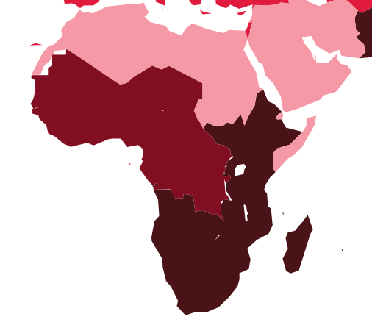
North Africa
1,223,017 cases
35,979 deaths
Middle East and North Africa
240,000 people living with HIV
20,000 new HIV infections
8000 AIDS-related deaths
COVID-19 in Africa
2.939 000 cases
74,372 deaths
Concentrated epidemics (key populations and their partners)
Humanitarian challenges
SGBV
Western and central Africa
4,900,000 people living with HIV
240,000 new HIV infections
140,000 AIDS-related deaths
Under-resourced response
Slower progress: low treatment levels
Women and girls and key populations at risk
Humanitarian challenges
Eastern and southern Africa
20.700.000 people living with HIV
730,000 new HIV infections
140,000 AIDS-related deaths
Women and girls (particularly AGYW) and key populations at risk
WCA
538,331 cases
7,629 deaths
ESA
2,253,793 cases
63,612 deaths
HIV data: UNAIDS 2019; COVID-19 data: WHO 14.03.2020
Notes:
Turning specifically to HIV and COVID-19, the data show these are real threats – particularly when related vulnerabilities are combined.

Slide 7
Humanitarian settings: Unstable, unpredictable, volatile
Notes:
Key populations – sex workers, men who have sex with men, transgender people, people who inject drugs and prisoners – are yet further impacted in emergencies. Existing barriers to services are exacerbated.

Slide 8
HIV and COVID-19
Disruptions of prevention, treatment and care services for PLHIV
6-months disruption of antiretroviral therapy could lead to more than 500,000 extra deaths from AIDS-related illnesses in sub-Saharan Africa (2020–2021).
Antiretroviral treatment for HIV-positive pregnant women is down 4.46% according to PEPFAR
Fragile communities are at higher risk of HIV infection
key populations : Those with disabilities, marginalized groups, people in hard-to-reach areas
Gender inequalities and stigma and discrimination
Notes:
COVID-19 has had and continues to have disproportionate impacts on those who are already most vulnerable – those with low or unstable incomes and in precarious living situations; those at risk of violence; those with already-restricted access to services; and those excluded from society. People living with, affected by and/or at risk of HIV are often part of these groups.

Slide 9
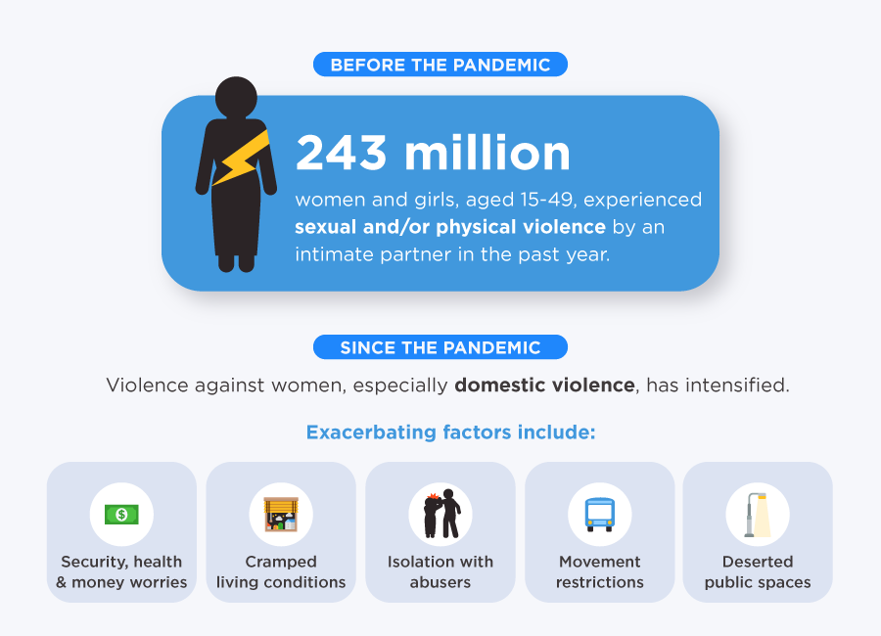
SGBV: The shadow pandemic
Sexual and gender-based violence typically increases in times of crisis.
Relevant services and mitigation measures (including HIV services and those for survivors of conflict-related sexual violence) are harder to access.
SGBV exposes survivors to HIV infection and other physical and mental impacts (which can lead to risk behaviours)
During COVID-19
Increase of 40% or more in reports of domestic violence in some countries
Increase in calls to domestic violence helplines in many countries
In some countries, resources and efforts have been diverted from violence against women response to immediate COVID-19 relief
Liberia recorded a 50% increase in gender-based violence in the first half of 2020: more than 600 reported rape cases.
Nigeria saw an increase of sexual violence during the curfews (including 2 young women raped and killed in June 2020.
In Kenya, nearly 4,000 schoolgirls reportedly became pregnant when schools were closed during the lockdown; in most cases they had allegedly been raped by relatives or police officers.
MINUSCA reported 27% more instances of rape and 69% more cases where women and children were hurt.
Notes:
COVID-19 has had and continues to have disproportionate impacts on those who are already most vulnerable – those with low or unstable incomes and in precarious living situations; those at risk of violence; those with already-restricted access to services; and those excluded from society. People living with, affected by and/or at risk of HIV are often part of these groups.

Slide 10
Mobility and COVID-19
COVID-19 has highlighted existing inequalities and rights violations
The threat is the virus: Not people; not migrants, refugees, stranded or displaced
persons.
COVID-19 is having a devastating impact on migration, human mobility and displacement
Travel restrictions and border closures have left many migrants stranded in often precarious situations.
Notes:
The threat is the virus: Not people; not migrants, refugees, stranded or displaced persons.
Migrants are not inherently more at risk of contracting or transmitting infectious diseases: the conditions in which they migrate, live or work influence or compound health risks, including access to health services.
COVID-19 is having a devastating impact on migration, human mobility and displacement
Travel restrictions and border closures have left many migrants stranded in often precarious situations.
Possible diminished avenues for safe, regular and orderly migration
Mobile and displaced populations are more likely to reside in overcrowded households, informal dwellings or camps/camp-like settings where capacity, resources and access to services are limited
Migrants are more likely to be precariously employed in the informal economy, with limited provision for (or fear of seeking access to) social protection, adequate food, housing, health and social services.

Slide 11
Solutions and recommendations
Notes:
So what can we do to address these vulnerabilities and barriers to services? How can we ensure that attention and resources are maintained for ongoing crises in the face of sudden disaster – whether these are new diseases, humanitarian emergencies due to conflict or the impacts of climate change? How can we ensure that key and vulnerable populations continue to have access to lifesaving HIV and other services? The key lies in ending inequalities.

Slide 12
Maintaining essential HIV services during COVID-19
Address stigma and discrimination and other inequalities of access
Prevent HIV transmission
Condoms; safe blood transfusion; PEP for survivors of SGBV; standard precautions in health facilities
Protect people on the move
Ensure refugees, migrants and IDPs are included in COVID-19 plans and receive the same attention and support as host communities
Ensure integration of services
Food and nutrition support; social protection
Address SGBV
Prevent and respond to SGBV, including through survivor-centred services
Ensure eMTCT services
For all pregnant, breastfeeding women and children with known HIV status.
HIV testing
In event of community transmission of COVID-19, HIV testing should be reserved for clinically indicated cases and when safe and according to standard infection control procedures.
Reduce morbidity and mortality
Ensure access to ART, anti-TB drugs and cotrimoxazole
Provide longer refills of ARV (3-6 months) when possible for stable patients.
Use existing community platforms to facilitate ART distribution.
Protect key populations
Continue essential preventive services
Notes:
The first step is to ensure that people living with or at risk of HIV have continued access to HIV services – and there are proven ways to do this.

Slide 13
Example of Good practices in Africa during the COVID-19 pandemic/restrictions
Community antiretroviral distribution in Burkina Faso, Côte d’Ivoire, Guinea Bissau, Liberia, Mali, Nigeria, and Senegal
Use of WhatsApp to support counselling of people living with HIV in Togo
Establishment of a supply chain situation room to ensure non-disruption in supply of HIV commodities at facility-level in Nigeria.
Multisectoral survivor-centred services in Kenya for survivors of sexual violence in conflict zones
Notes:
A number of countries in Africa have shown that it is possible to protect people living with or at risk of HIV even during a pandemic.
These examples show what can be done – and we should learn from these good practices, scale up, adapt and implement.

Slide 14
Leveraging lessons learned from the HIV response
End inequalities Put people at the centre Rights-based solutions
Location and population approaches: where, why and for whom?
Community-based solutions to
Reach those who are left behind and vulnerable,
Promote well-being and reduce stigma and discrimination
An enabling and empowering legal and political environment
Health systems strengthening and UHC
Sustainable and continuous resourcing
People vaccine : Covid-19, HIV vaccine !!!
Notes:
Central to all of these solutions are cooperation, the involvement of communities and the determination to ensure no one is left behind – that no one stands unequal in the response to HIV (and other health threats). UNAIDS has learned valuable lessons in its years fighting HIV – and these can be leveraged both to the benefit of people living with or at risk of HIV and more broadly.
Thank you for your attention and I look forward to hearing your questions and comments later in the session.

Slide 15
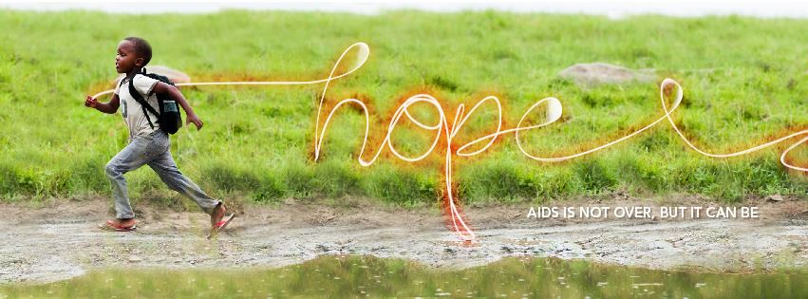
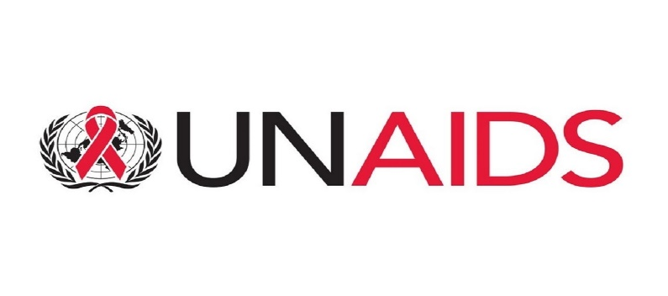
There is still a long way to go...
Thank you
MAMADI DIAKITE, Special Adviser
Security, Humanitarian and Fragile Countries

