Slide 1
Faith Based Philanthropy as a Solution for Africa
Khaled Khalifa - UNHCR
Senior Advisor
Representative to the Gulf Cooperation Council Countries

Slide 2
Africa – Facts & Figures
54 countries
1.34 billion people (2020)
Total GDP of $2.33 trillion (2020)
27 African countries are OIC members (57)
40% of population is Muslim = 533 million people
African diaspora (2013-2018)
140 million people
$50 billion total savings
Zakat of diaspora: 2.5% of 40% (Muslim population) of $50 billion is: $500 million.
Sub-Saharan Africa hosts more than 26 per cent of the world’s refugee population.
Over 18 million people in this region are of concern to UNHCR; number on the rise due to Covid and ongoing conflicts
Refugees 6,348,744
Asylum seekers 529,570
IDPs 18,511,592
Stateless 974,988
Notes:
Sources:
- Population: https://population.un.org/wpp/Download/Standard/Population/
GDP: https://www.imf.org/external/datamapper/NGDPD@WEO/OEMDC/ADVEC/WEOWORLD
% of Muslims: Research Gate (2009)
Diaspora: https://www.ghanaweb.com/GhanaHomePage/features/Africa-disapora-555915
African Development Bank - The African diaspora is important. There are around 140 million Africans living abroad. “About one third are middle class,” notes Olivier Eweck, Director, Financial Technical Service Division at the AfDB. “Total savings by the diaspora is estimated at $50 billion,” he pointed out.
https://www.unhcr.org/africa.html/https://reporting.unhcr.org/africa

Slide 3
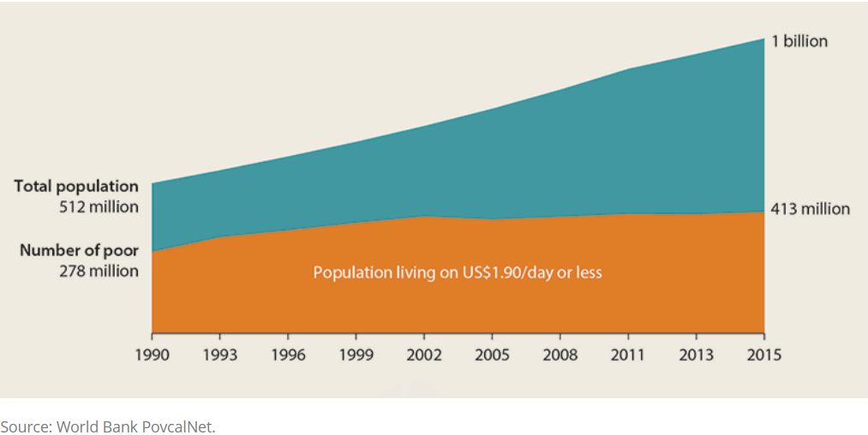
Poverty in Africa
While the number of people in Africa living in extreme poverty dropped from 54% in 1990 to 41% in 2015, the number of people living in poverty has increased from 278 million to 413 million.
Sub-Saharan Africa accounts for roughly 60% of the global population living in poverty in 2020.
According to World Bank estimates, 20% of all people in sub-Saharan Africa will still be living in poverty in 2030 unless the governments of Africa significantly step up their poverty reduction efforts.
Notes:
Sources:
Poverty: World Bank Group (https://www.worldbank.org/en/region/afr/publication/accelerating-poverty-reduction-in-africa-in-five-charts) “Extreme poverty”: less than $1.90 per day
Sub-Sharan Africa accounting for 60%: Pardee Center for International Futures at the University of Denver
The global population living in poverty (less than $1.9 a day) in 2017 was 689 million people (Source: https://www.worldbank.org/en/topic/poverty/overview)
World Bank estimates: https://www.dw.com/en/africa-more-poverty-despite-economic-growth/a-52840817

Slide 4
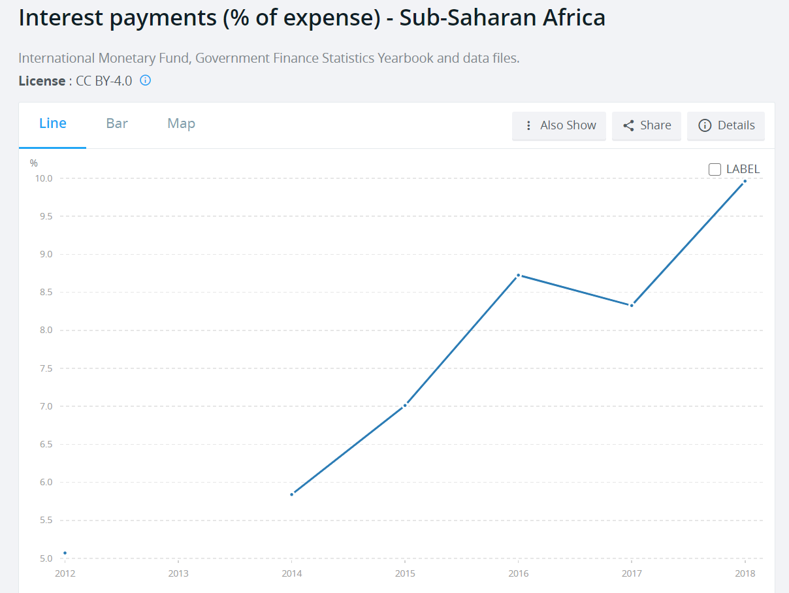
Relevance of Islamic finance for Africa
Relevance of Islamic finance for Africa
Based on Equity & Justice
Based on risk sharing – money ‘becomes actual capital only when it joins hands with other resources to undertake a productive activity’
Transactions are backed by real assets or economic activities (prohibition of creation of interest-based debt through direct lending and borrowing)
Non-Shariah/unethical activities are forbidden (gambling, weapons…)
Interest is forbidden (vs current system leading to interest representing 10% of Sub-Saharan Africa’s expenses)
Speculation is forbidden; cannot be involved in contracts where the ownership of goods depends on an uncertain event in the future.
Islamic finance can increase access to finance (including SME and microfinance sectors) and can help bridge the infrastructure gap in Africa.
Notes:
Sources:
https://www.islamic-banking.com/explore/islamic-finance
https://data.worldbank.org/indicator/GC.XPN.INTP.ZS?end=2018&locations=ZG&name_desc=false&start=2012&view=chart
Waren Buffet said – “derivatives are financial weapons of mass destruction, carrying dangers that, while now latent, are potentially lethal."
Last sentence (in the box): https://www.weforum.org/agenda/2017/10/islamic-finance-could-be-the-answer-to-africas-growth-problems/

Slide 5
Relevance of Islamic Philanthropy tools that could improve remittances, and boost local economies
Islamic philanthropy (IP), also called Islamic social finance, refers to financial mechanisms (donations, investments) found in Islam to fight poverty and foster socio-economic development for all.
What is needed in Africa
Continuous funding
Sustainable projects
Self-dependency: funding from Africa to Africa
Funding infrastructures for development projects
IP solutions
Zakat, Waqf, Ramadan
Waqf, Sadaqah Jariyah
Zakat spent locally (from Africans to Africans), Waqf
Sukuk

Slide 6
Zakat
Zakat reenergizes the markets: the ‘income multiplier’ effect of giving Zakat as cash
Zakat contributes to improving remittances figures.
Zakat secures more independence at the country level.
Estimates of the potential of Zakat
Country | % of GDP
Nigeria | 2.08
Sudan | 3.47
Tanzania | 1.3
Source: Global Report on Islamic Finance – Islamic Finance: A Catalyst for Shared Prosperity. World Bank and Islamic Development Bank Group
Notes:
INCOME MULTIPLIER FOR CASH ASSISTANCE Rwanda A study in Rwanda found that humanitarian assistance for refugees has a positive impact on the economies of surrounding host communities. Every dollar’s worth of food for refugees increased real income for the community around a camp by US$1.20. In two other camps where refugees received monthly cash assistance instead of food, each dollar they received translated into US$1.51 to US$1.95 in the local economy. Uganda A study conducted in Uganda found that cash assistance given to refugees produces an “income multiplier” for host communities. Each dollar increased real income in and around the settlements by an additional US$1 and US$1.50.
METHODOLOGY TO ESTIMATES ZAKAT Zakat estimates are based on views of the Maliki School, in which the zakƗt base includes buildings and other fixed assets, except those assigned for personal and family use. Zakat is collected from the rich Muslims only, and non-Muslim citizens are exempt from the payment of zakƗt. Thus the GDP of each country under study has been adjusted by taking into account per capita income and the proportion of Muslim population in each country. The average score of Zakat estimates has been applied as a proxy to estimate potential zakat collection for the countries.
LINK TO THE REPORT
https://openknowledge.worldbank.org/handle/10986/25738

Slide 7
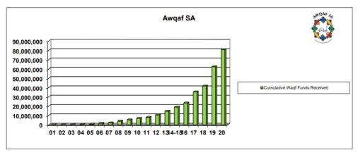
Waqf
Few African countries are benefiting from the potential of Waqf.
Countries with largest waqf institutions include Nigeria, Senegal and South Africa.
Awqaf: South Africa received $5.15 million of waqf funds in total, with an annual revenue in 2020 of $230 thousand.
Notes:
Source : https://awqafsa.org.za/wp-content/uploads/2021/01/AWQAF-SA-Financial-Graphs-2001-2020.pdf

Slide 8
Sukuk - $23 billion so far
Number of Sukuk Issuances in Africa (Jan 2001 - Dec 2019)
Country | Number of Sukuk | Total amount in USD millions
Sudan | 36 | 19,646
Nigeria | 5 | 864
South Africa | 1 | 500
Ivory Coast | 2 | 460
Senegal | 2 | 445
Gambia | 429 | 407
Mali | 1 | 285
Togo | 1 | 245
Morocco | 1 | 105
AFRICA TOTAL | 478 | 22,957
GLOBAL TOTAL | 9,356 | 995,764
% of AFRICA | 5.11% | 2.31%
Sukuk is an efficient tool of social investment in Africa’s current situation
Growing potential for Africa's developing sukuk market to help achieve the continent's funding requirements for its extensive infrastructure development.
First country to issue Sukuk was Sudan in 2007
Potential for non-Muslim countries as well: South Africa and Ivory Coast.
Source: Sukuk Report, 2020. International Islamic Financial Market.
Notes:
Sources:
Table from: https://www.iifm.net/wp-content/uploads/2020/09/IIFM-Sukuk-Report-9th-Edition.pdf
https://www.weforum.org/agenda/2017/10/islamic-finance-could-be-the-answer-to-africas-growth-problems
https://issuu.com/cpifinancial/docs/ib_f_issue_119_for_issuu
https://www.cliffordchance.com/content/dam/cliffordchance/briefings/2017/12/sovereign-sukuk-in-africa-a-developing-landscape.pdf

Slide 9
Challenges and solutions:
Flexibility in Zakat collection and distribution in developed countries.
Restructuring Zakat programmes in developing countries.
Develop regulatory frameworks to promote Islamic finance products in developing countries.
→ Promote the use of faith-based philanthropy and finance tools that follow an inclusive approach.
Notes:
Flexibility in Zakat collection and distribution in developed countries: Religious establishments in developed countries could avoid rigid regulations related to the collection and disbursement of Zakat in particular.
Restructuring Zakat programmes in developing countries: The Zakat collection and distribution system in Africa could be modernized and include checks and balances to gain confidence of potential donors.
Develop regulatory frameworks to promote Islamic finance products in developing countries: legislating and enforcing legal frameworks in African countries to encourage IP financial tools such as Sukuk and cash Awqaf.

Slide 10
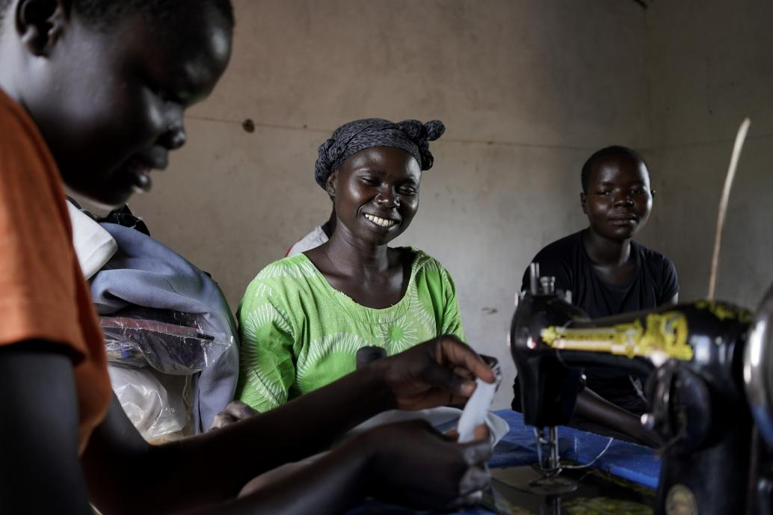
Thank you.

