Slide 1
Burundi
Liberia
Libya
Rwanda
Somalia
South Sudan
Tunesia
Develops higher (vocational) education
and entrepreneurship to
empower young, ambitious
people to lead their fragile
and conflict affected
societies into prosperity.
AFRICA: Population Growth, Urbanization, Education and Employment
Drs. Yannick Du Pont, DIHAD March 16 2021

Slide 2
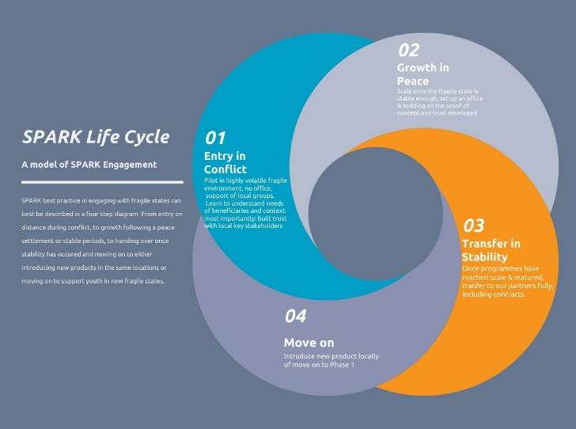
SPARK Model of Engagement

Slide 3
Our four areas leading to jobs
Scale Up
Start Up
Match Up
Skill Up
Jobs are created by scaling growth-oriented SMEs through coaching and facilitating SMEs better access to finance and markets
Jobs are created supporting promising high potential entrepreneurs with coaching and access to finance and to markets
Enabling target beneficiaries to access jobs through market relevant (higher) vocational education and internships/ traineeships
More entrepreneurs emerge by making curricula more market-relevant, and by introducing entrepreneurship training

Slide 4
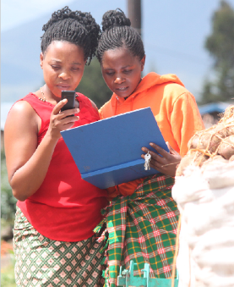
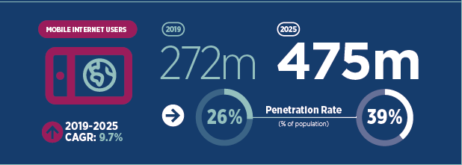
COVID: More rapid digitalisation ?
Covid accelerated pre-existing trend
Application of technology in programmes
Greenfield new start-ups, new products
Still 800 Million to be connected

Slide 5
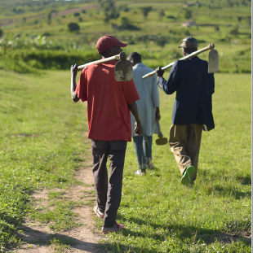
Digital Finance Access for Potato farmers Rwanda
Personalised dashboard tracks harvest & sales, used as bankable data for loans
Initial results
9,027 Smallholder farmers
5,066 tons of Irish Potato
Farmers open mobile accounts
Scalable model

Slide 6
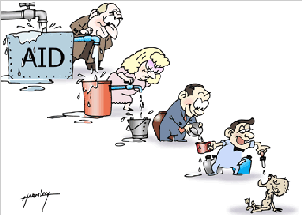
COVID: More rapid localisation ?
Grand Bargain WHS
Lobbied NL regulation
Joined the Charter for Change
Acceleration inevitable or vested interested still stronger?

Slide 7
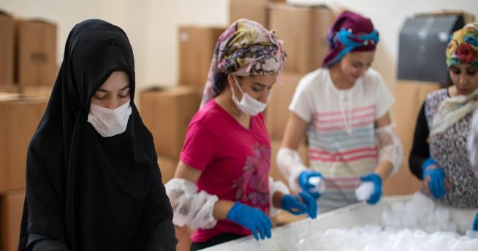
Localisation: Tadamon
IsDB Tadamon Accelerator Programme - Safegaurding jobs during the Pandemic
Local co-creation and implementation
Internships and startups support
Market driven TVET Skilling
Support health workers

Slide 8
East/West Partnership

Slide 9
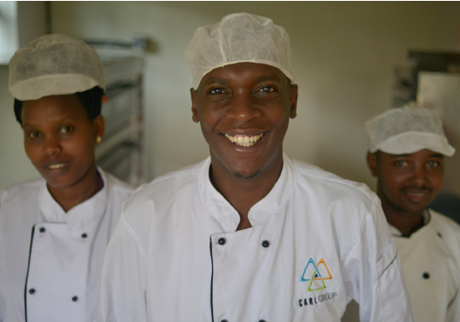
Rebuilding futures
economies and communities

