Slide 1
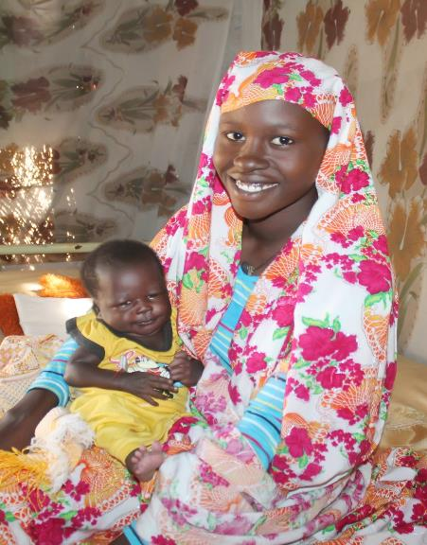
Africa: population growth, education and employment pandemic
COVID-19 and
the demographic dividend
DR. LUAY SHABANEH
REGIONAL DIRECTOR
UNFPA ARAB STATES REGIONAL OFFICE
Notes:
Good morning. Thank you for attending this

Slide 2
Presentation Outline
1
Understanding the Demographic Dividend
2
Harnessing the Demographic Dividend in Africa:
Challenges and Opportunities?
3
UNFPA Approach to Harnessing the Demographic Dividend and Accelerators
Impact of Covid-19 in Africa and Increased Inequalities
4
5
Recommendations
Key Takeaways
5

Slide 3
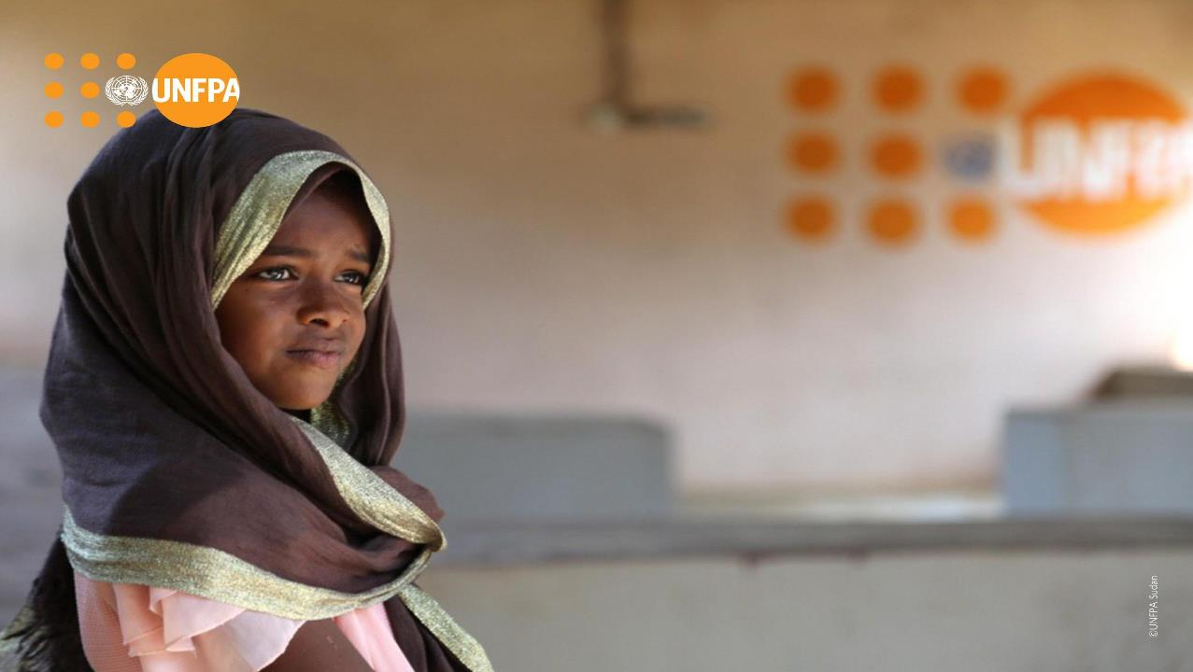
Defining the Demographic Dividend
African Union (AU) in its Roadmap on Harnessing the Demographic Dividend (2017) Define DD as, “The benefit that can arise when a country has a relatively large proportion of working-age population due to declining fertility, and effectively invests in their health, empowerment, education and employment through public action and private sector involvement

Slide 4
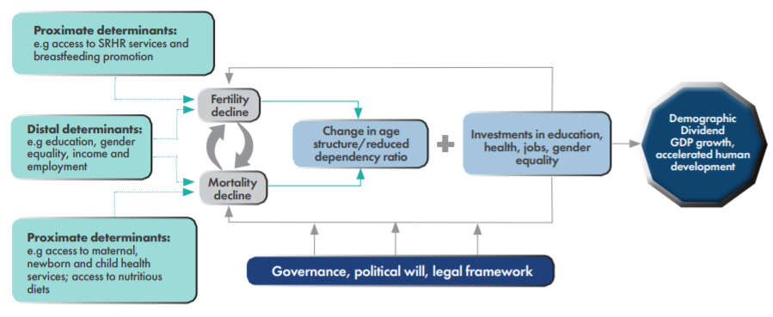
Conceptual Framework for Harnessing the Demographic Dividend (DD)

Slide 5
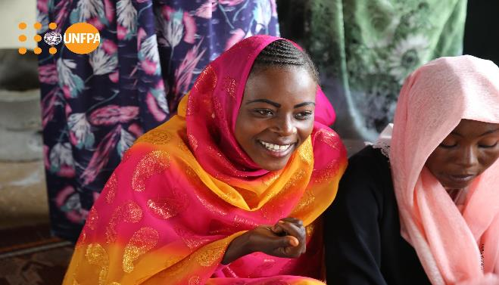
Harnessing the Demographic Dividend in Africa:
Challenges and Opportunities?

Slide 6
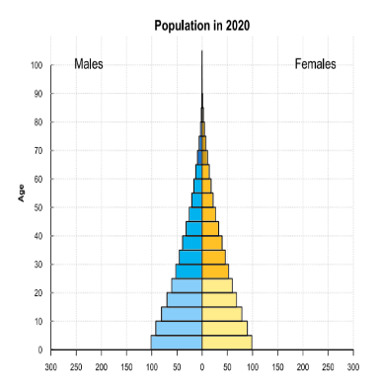
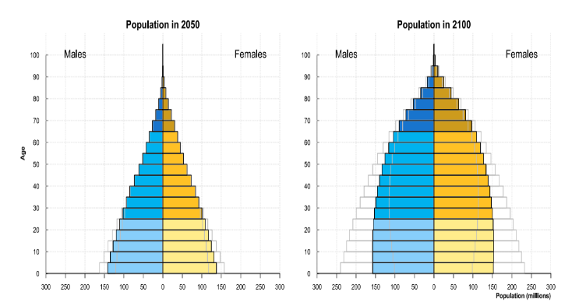
Where is Africa from the Demographic Dividend?
Almost two of every three people—or 660 million—are still living on less than $2 per day.
Accelerated economic growth is needed to reduce inequality and poverty, and improve people’s lives across Africa
Labor and capital markets should be ready for the change in the population age structure
Source: https://population.un.org/wpp/Graphs/1_Demographic%20Profiles/Africa.pdf
Notes:
Compared to the rest of the world, Africa is youthful.
The United Nations (UN) estimates that 60% of Africa’s population is under 25 years of age compared to a global average of 41%.
The region can capitalise on this youthful population to benefit from the Demographic Dividend (DD) which is reference to the economic benefit arising from a significant increase in the ratio of working-age adults relative to young dependents.

Slide 7
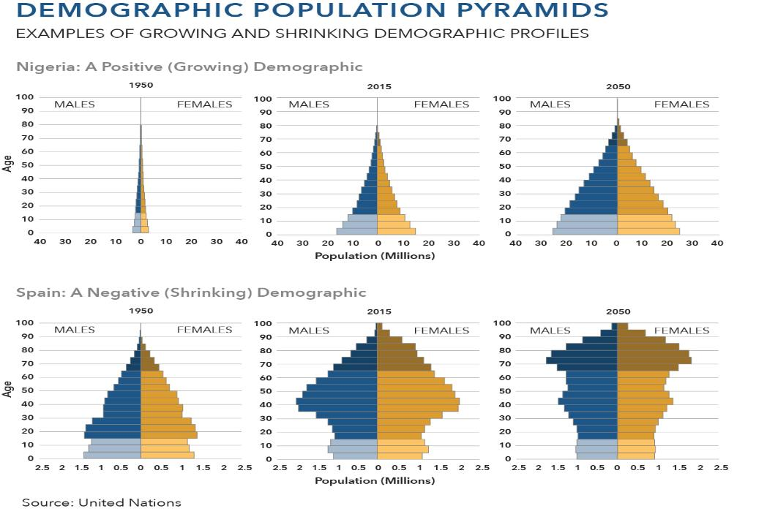

Slide 8
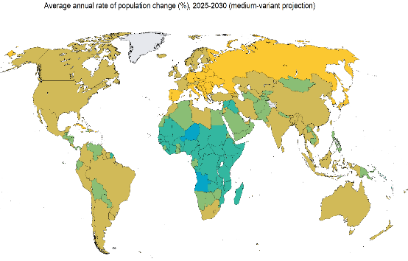
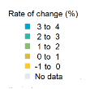
Africa: the fastest population growing continent
Africa has the highest population growth rate (2-4) and highest TFR (3-6.5)
Population is expected to double by 2050 with a GDP more than 5% per year
Compared to the rest of the world, Africa is youthful. The United Nations (UN) estimates that 60% of Africa’s population is under 25 years of age compared to a global average of 41%
Median age is 19.7 years
Age dependency ratio (percent of working age population) is 84
Failure to absorb the large working-age population into productivity could negatively impact African economies
Working on enhancing the demographic dividend is a must
2019 UN, DESA, population division. Licensed under Creative Common license CC BY 3.0 IGO

Slide 9
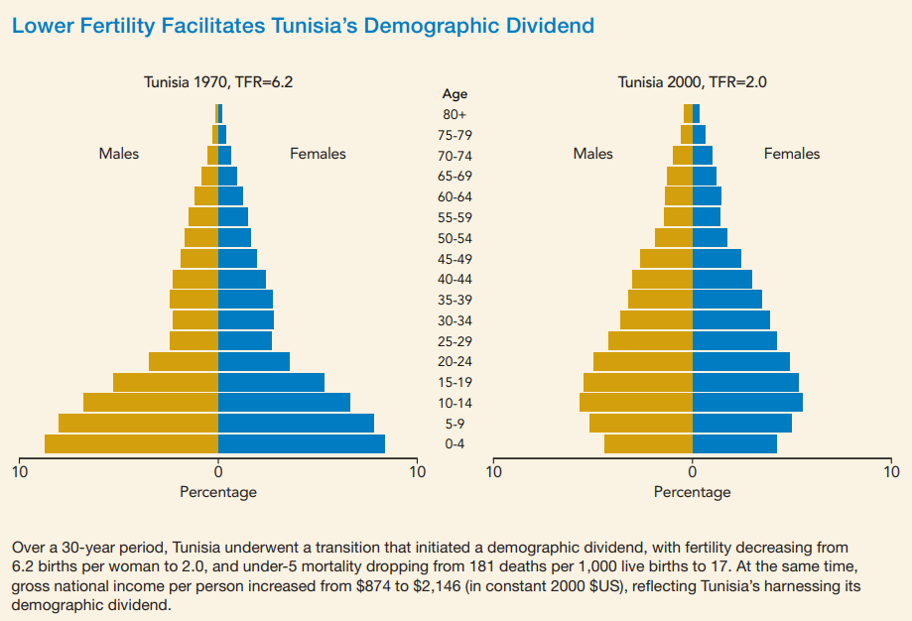
Example: Tunisia as a Country Harnessing the Demographic Dividend
Over 30 years
TFR decreased from 6.2 to 2
Under-5 mortality dropped from 181/1000 to 17
Gross National Income increased from $874 to $2, 146
Notes:
With fewer births each year, a country’s working-age population grows larger in relation to the young dependent population

Slide 10
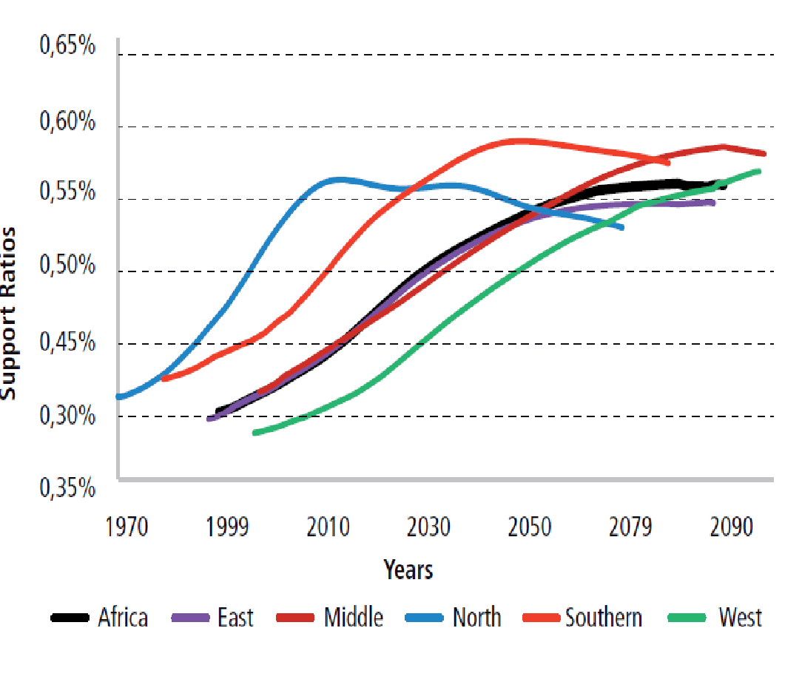
Africa: Representing Differentiated DD Attainment
The Timing and Intensity of the DDs in African Sub-Regions Vary Considerably:
In 1975, Northern Africa was the first sub-region to enter the DD phase; its window of opportunity is projected to close by 2028.
The next subregion to enter the DD phase was Southern Africa, in 1979; this situation is projected to continue until 2058.
East Africa is close to the regional average, with a DD that started in 1988 and likely to end by 2078.
West and Central Africa were the last sub-regions to enter the DD phase, in 1997 and 1998, respectively. According to current population projections, the DD will last the longest, until 2103 in West Africa and 2099 in Central Africa.

Slide 11
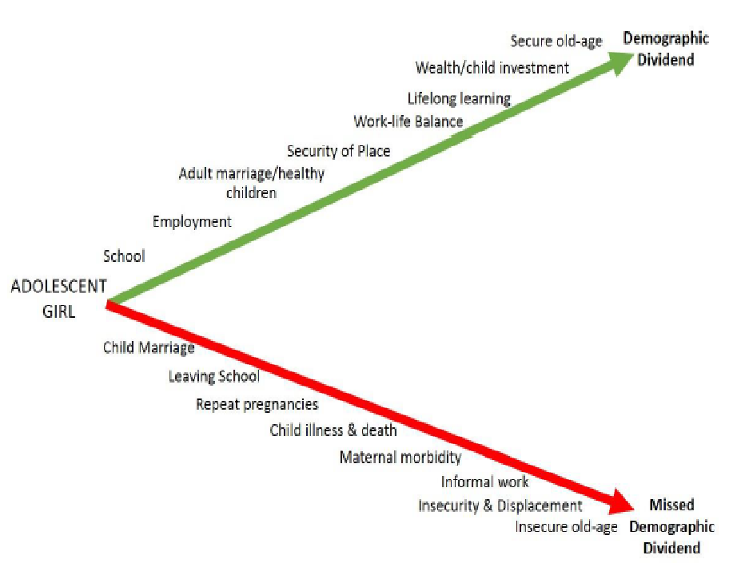
UNFPA’s Approach to Harnessing the Demographic Dividend- Zooming on Girls
Young people need to reach their potential through working opportunities
Workers have fewer dependents (as a result of voluntary family planning and SRH services)
Girls in particular could be a missed opportunity in the African communities
UNFPA model suggests trajectories with three accelerators:
Education
Empowerment
Employment
The demographic dividend can speed up the attainment of the Sustainable Development Goals

Slide 12
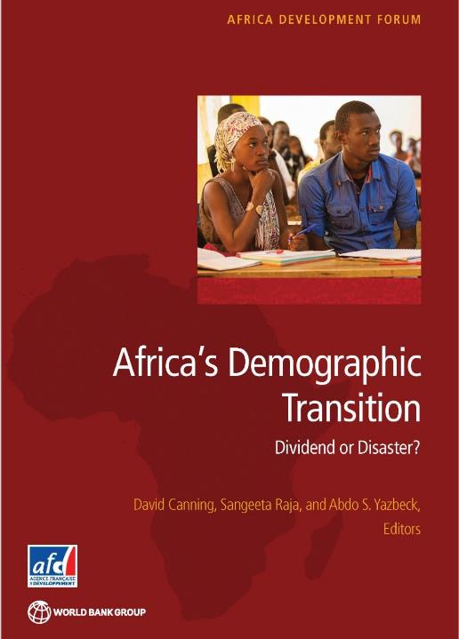
Harnessing the demographic dividend means empowering women and girls by:
Improving their health
Enhancing their human capital through investment in education and skills
Providing them with greater market, social, and decision-making power.
Proactive Social policies
2015

Slide 13
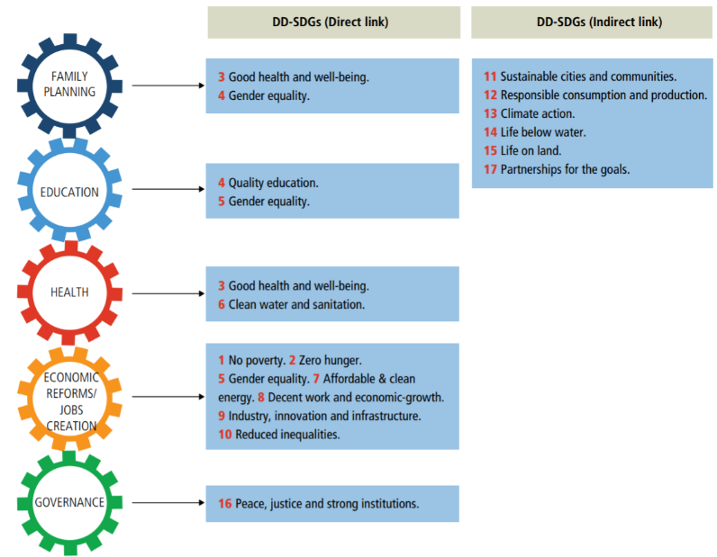
The Demographic Dividend and the Sustainable Development Goals (SDGs)
Notes:
To Link our actions in the SDGs in UNFPA’s role in Harnessing the DD section

Slide 14
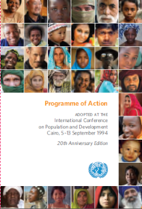
UNFPA supports the Rights Approach through the ICPD to Enhance the Demographic Dividend (DD)
ICPD in 1994 supported DD and its relevant policies in the PoA through the rights approach that focuses on raising skills, knowledge and opportunities through policies related to education, health and cultural addressing young people
ICPD@25 was celebrated at the Nairobi Summit where recommendations to support DD included:
Universal access to sexual and reproductive health and rights as a part of universal health coverage and in humanitarian and fragile contexts
Focusing on empowerment of the adolescent girl and closure of the gender gap
Drawing on demographic diversity to drive economic growth
Ensuring data availability and analysis for adequate monitoring
Notes:
The United Nations Population Fund (UNFPA), as the leading international agency on population and development issues, prioritized strategic support to countries in their efforts to take advantage of the DD by providing them with this Demographic Dividend Programming Guide. The need for such a Programming Guide has been expressed widely by governments and throughout the development community.

Slide 15
UNFPA Accelerators and ICPD Rights Approach to Achieve Harnessing the Demographic Dividend In Africa
Sustainable Development Goals
ICPD PoA and UNFPA Transformative Results
Scaling demand interventions for young people
Delivering quality SRH and FP services
Ensuring services in humanitarian settings
Ensuring contraceptive methods and commodities
Data
Comprehensive package of SRH interventions
Positioning SRH quality services in UHC
Ensuring quality services in humanitarian settings
Scaling Midwifery services
Data
Policy and Legal frameworks
Strengthening social actions
Tackling harmful and discriminatory practices
Ensuring gender equality
Scaling up quality GBV services
Empowering decision of women and girls
Ending Unmet Need for Family Planning
Ending Maternal Mortality
Ending Gender Based Violence and Harmful Practices

Slide 16
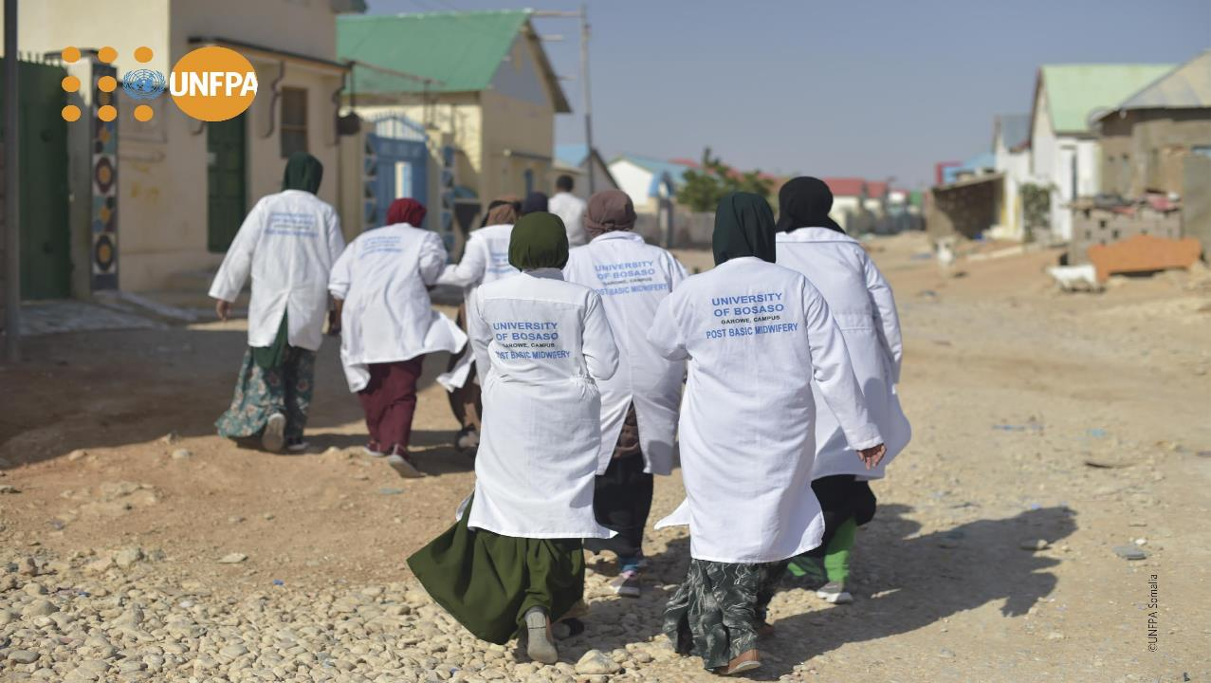
Impact of Covid-19 in Africa and Increased Inequalities

Slide 17
COVID19: Setback and unprecedented global challenge
Global COVID-19 deaths exceeded 2.5 millions with more than 115 million infections
COVID-19 devastated the global economy and severely harmed critical pillars of society including:
provision of education and healthcare
community activities that are key for physical and mental health
Impact on countries with higher rates of poverty and fragile systems
Evidence from previous health crises show that women and adolescent girls are disproportionately affected
Scaling down implementation of community interventions related to ending child marriage interventions by one year, on average, will see an estimated 7.4 child marriages (could have been averted)
Government measures to contain the crisis- such as lockdowns – impacted people working in the informal sector (women and young people)
Increasing Population
Rapid GDP growth
COVID-19
Need for more job creation

Slide 18
Impact of Covid-19 in Africa and Increased Inequalities
Total number of cases exceeding 3.6 M and a total deaths approaching 90K coupled with fragile health systems diverted resources away from SRH and family planning services
Lockdown reduced community interventions especially targeting adolescent girls with evidence of increased child marriage
Increased maternal mortality and GBV in humanitarian settings
Disruption of education services due to lockdown; more in poor communities
Disruption of education and skill development of young people
Decrease in working hours and contribution to poverty (10% decrease in working hours among those employed in Arab African countries resulted in losing jobs more among women

Slide 19
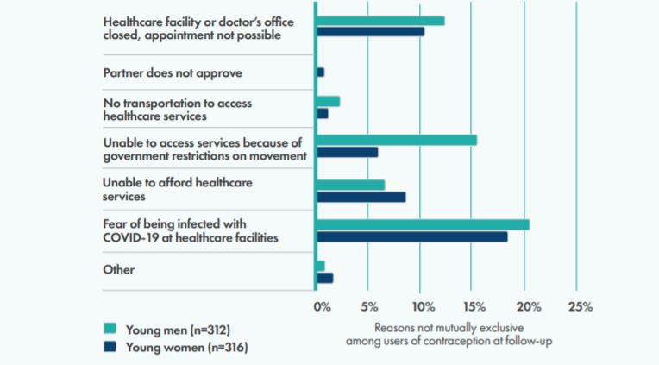
Disruptions to contraception for adolescents and young adults (age 15-24) in Nairobi, Kenya during COVID-19
Example from a Study in Kenya

Slide 20
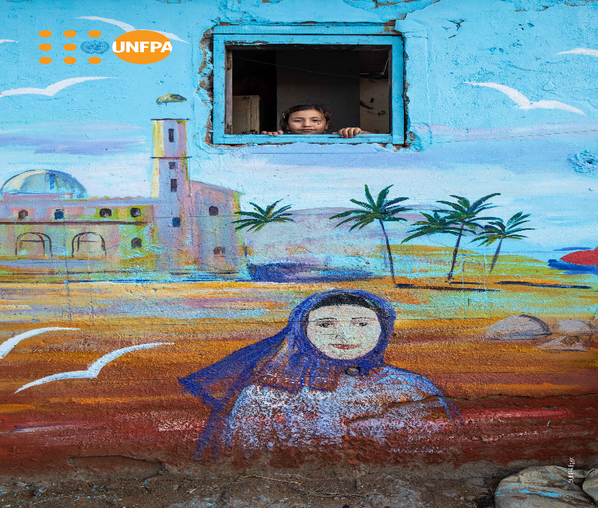
RECOMMENDATIONS

Slide 21
Recommendations I
Put in place measures to fully resume service delivery in the health sector that will safeguard SRHR and family planning programmes including service delivery to the youth.
Map and invest in addressing other emerging priorities that have been observed to have intensified during the pandemic including SGBV and mental health.
Implement return-to-school strategies that will ensure minimal drop-out and in particular, take measures to ensure that the disadvantaged groups as well as girls do not drop out of school.

Slide 22
Recommendations II
Deploy an economic recovery strategy that will safeguard informal sector jobs and extend social protection to the most vulnerable in the communities during the recovery period.
Develop a youth centred post COVID-19 recovery strategy.
Invest in data and measurement to inform both the short-term and long term responses to COVID-19 and similar episodes that may occur in the future.

Slide 23
Takeaways
Africa to continue efforts in mitigating risks and impact of COVID-19 on Population and Development
Countries to realize rewards of growing labor force; policymakers need to make investments that:
Creates smaller and healthier families, to reap DD
Improve human capital particularly for adolescents' girls who can save/break the DD process
Strengthen resilient health systems to absorb future shocks like COVID19
Empower women to enjoy their right to life, safe childbirth, and control their own bodies
Empower young people to reach their full potential
Adopt a path-way approach to reap DD that builds on accumulating the potential of partnership with private sector and community participation.
Avail the necessary and required data to monitor progress
Notes:
A demographic dividend is possibility for many African nations, but countries must prioritize strategic investments to lower fertility and child mortality.
Address high birth rates through family planning, education, and other investments that contribute to smaller and healthier families.
Smaller numbers of children per household generally lead to larger investments per child, more freedom for women to enter the formal workforce and more household savings for old age. When this happens, the national economic payoff can be substantial.

Slide 24
Africa is not Empty Continent
Not-Work for Africa
Yes-Work with Africa

